Slide 1
Come and join us this summer for a week of handbell ringing!
July 8-12th 2018
Heartland Center - Parkville, MO

Slide 2
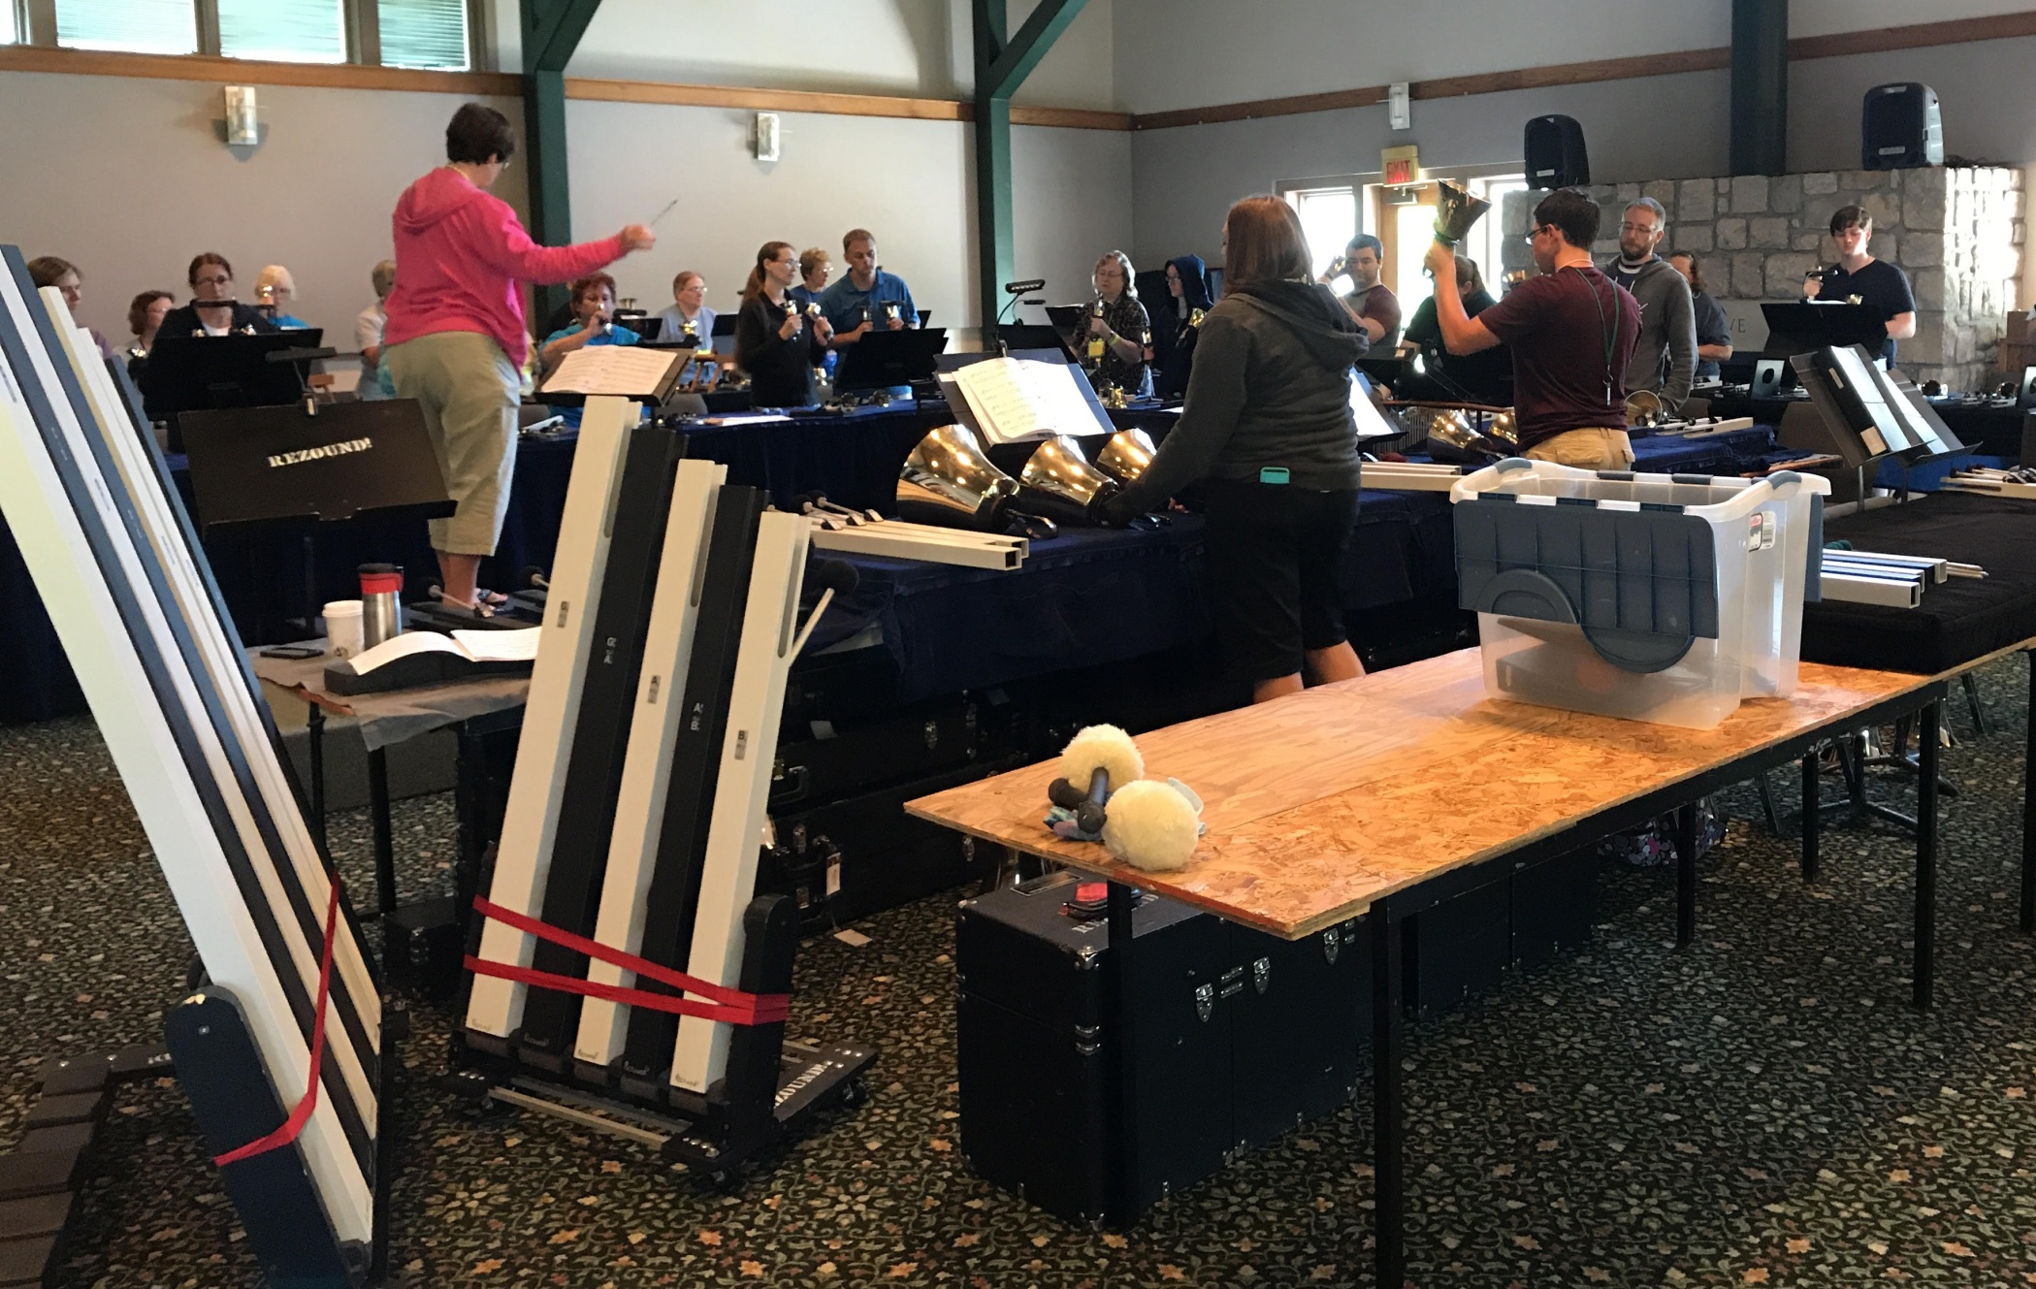

Slide 3
*Ring with everyone
*Ring in your choir
*Ring in a class

Slide 4
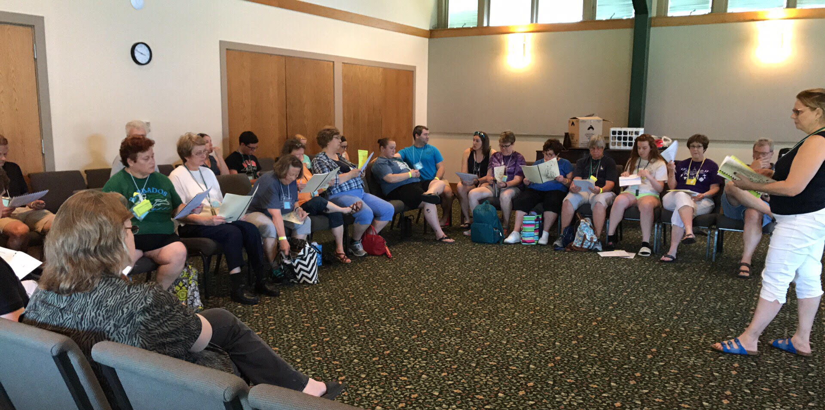
*Bring a friend or two
*Make new friends

Slide 5
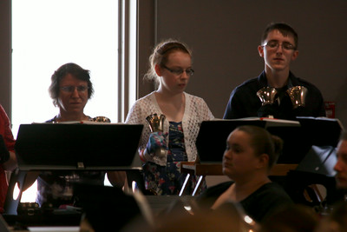
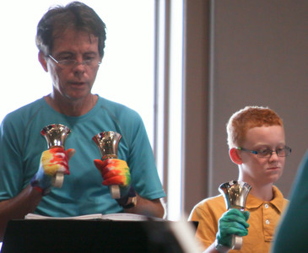
*Adults and teenagers
*Optional outdoor activities
*Optional skills classes

Slide 6
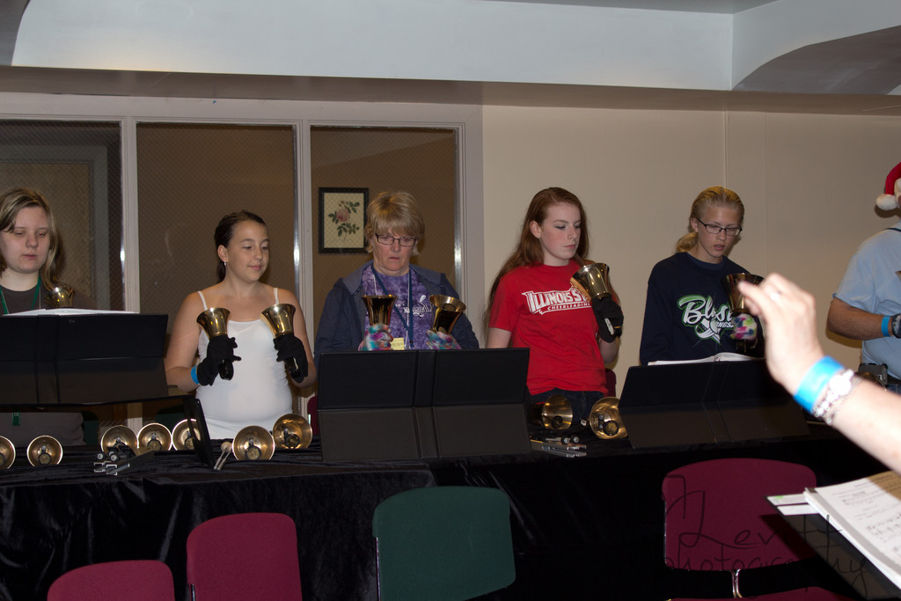
Ability level choirs, massed ringing

Slide 7
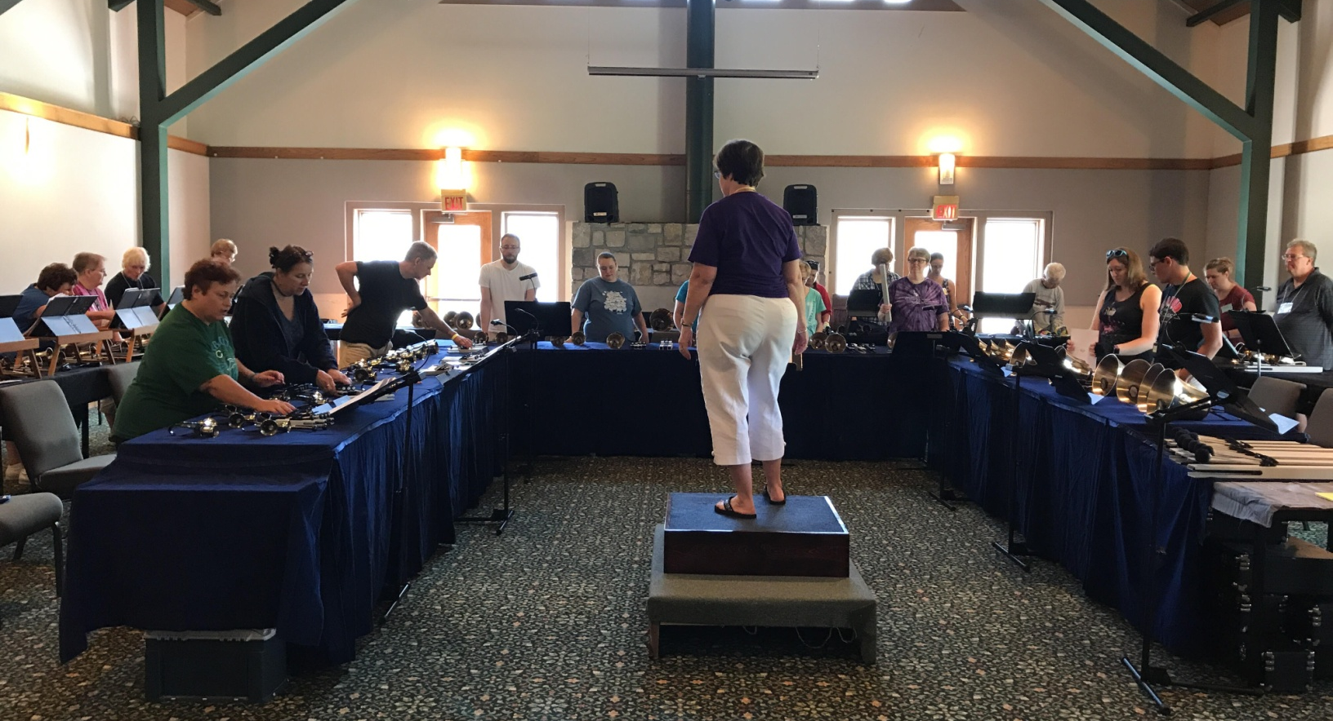
*Improve your ringing skills
*Challenge yourself in new ways
*Try new music

Slide 8
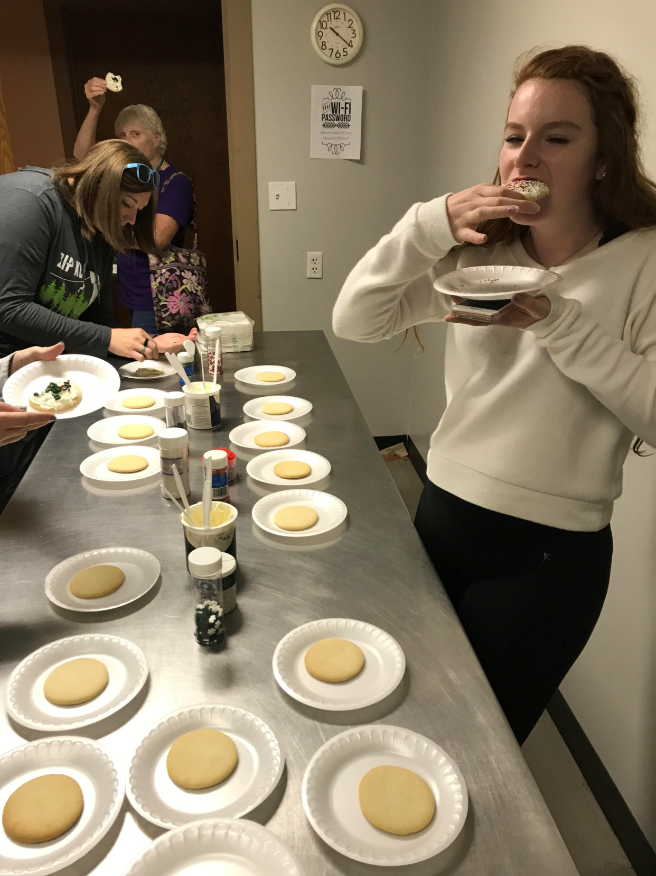
*Good meals
*Comfy rooms
*Terrific
snacks
*Excellent
teachers
*Great music

Slide 9
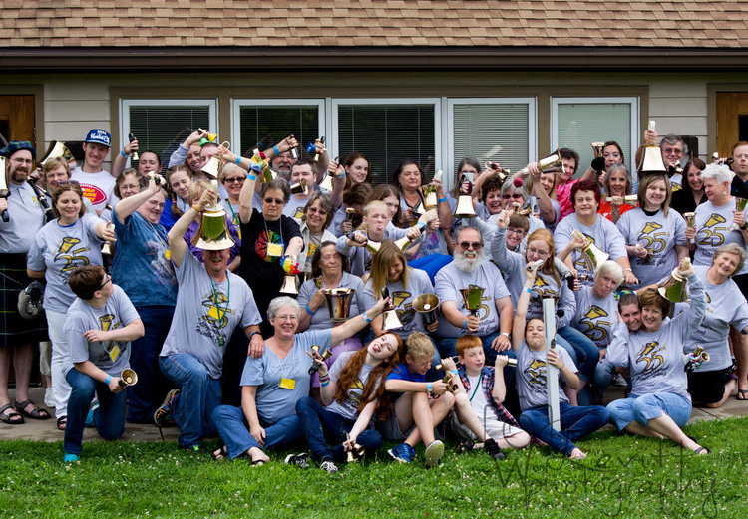
Handbell Camp 2015

Slide 10
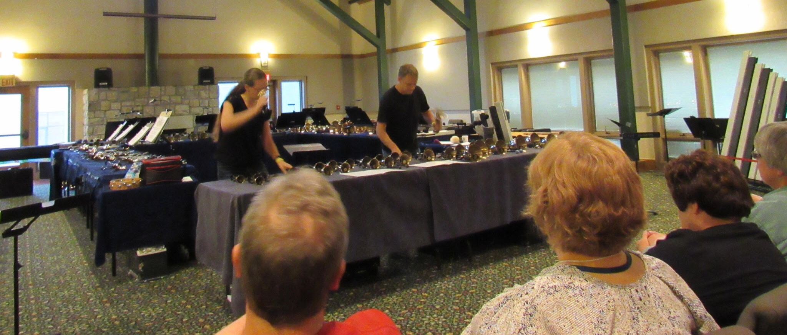
*Fun evening activities include
a talent show…

Slide 11
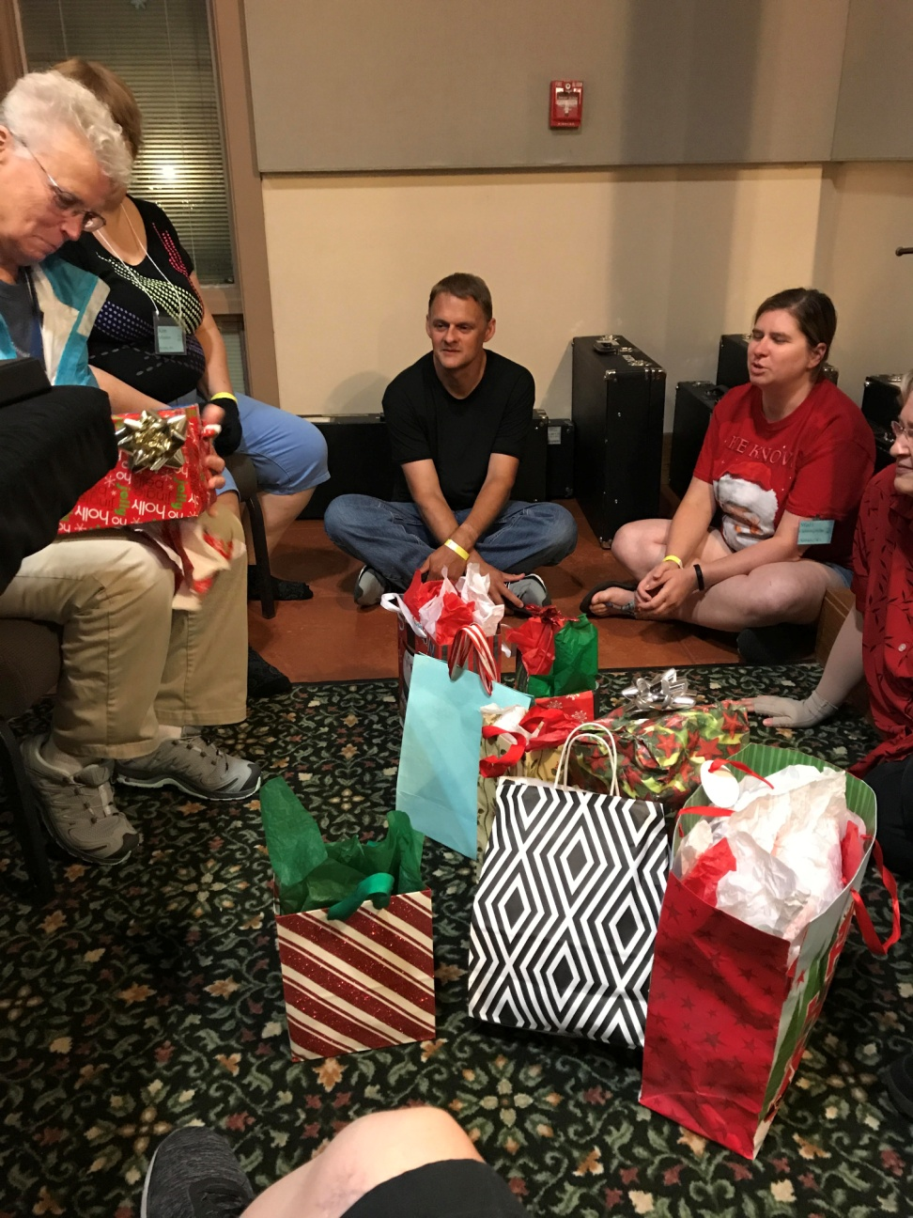
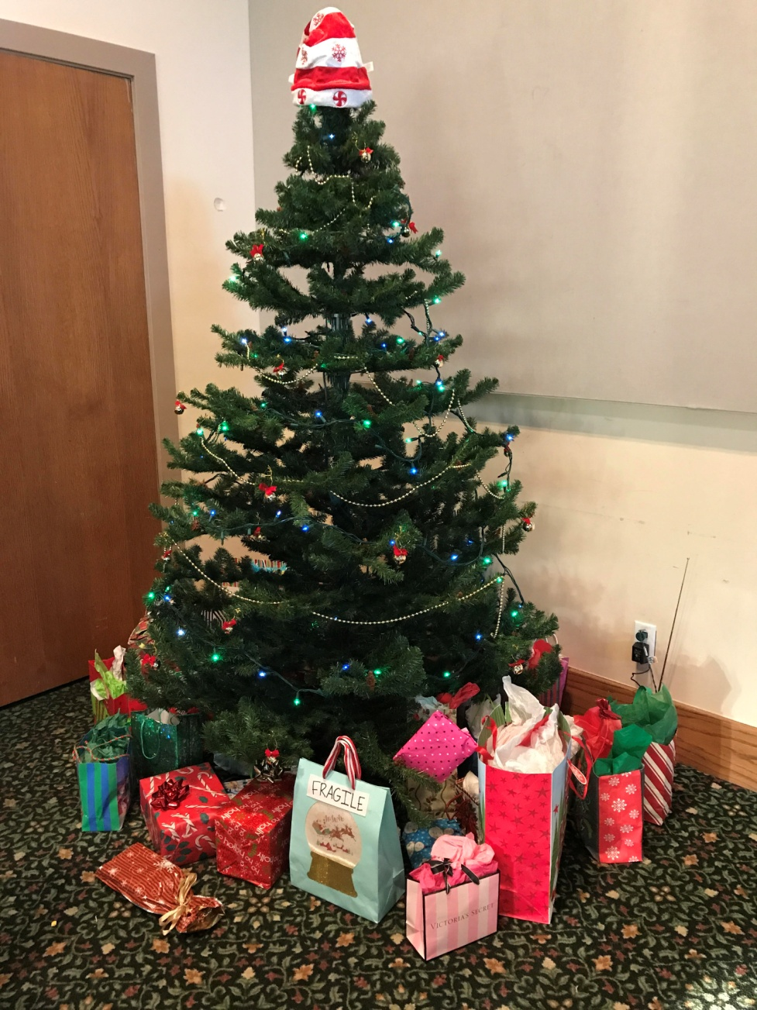
…and Christmas in July!

Slide 12
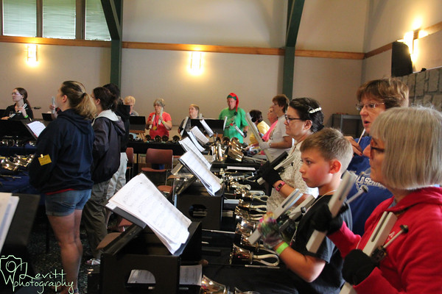

Slide 13
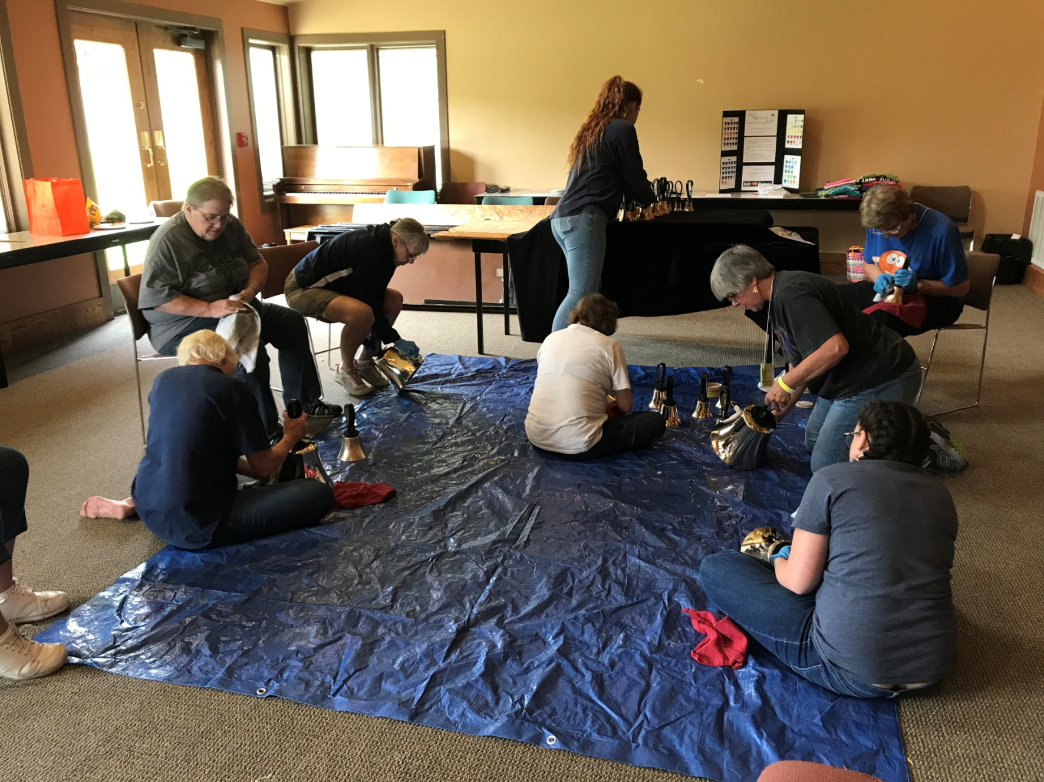

Slide 14
Handbell Camp 2016

Slide 15
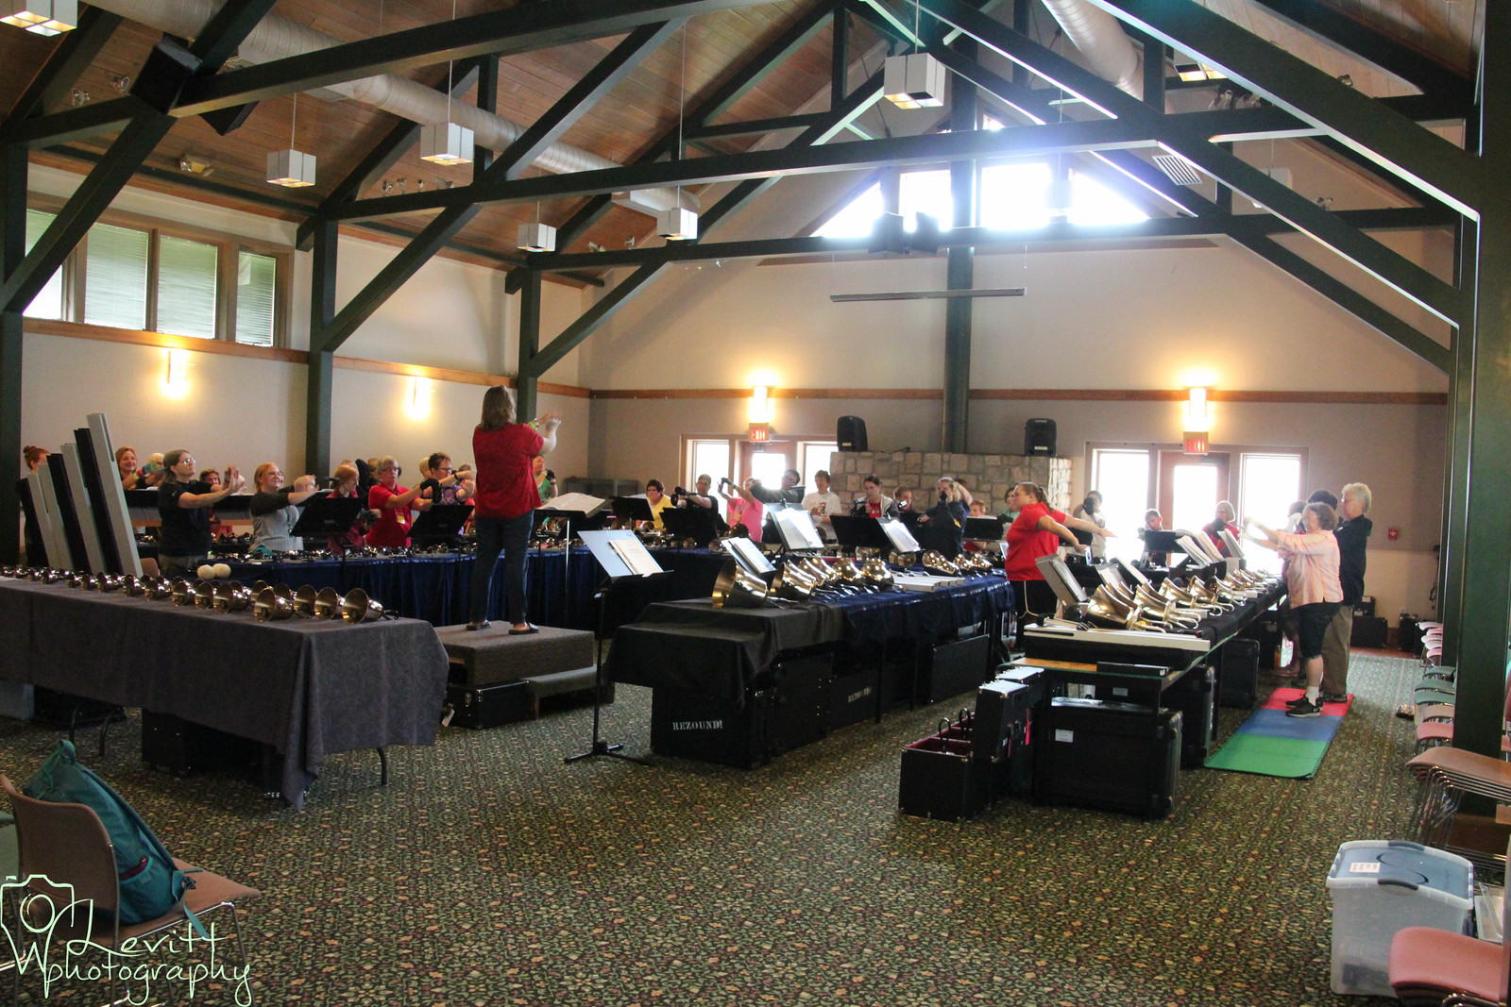

Slide 16
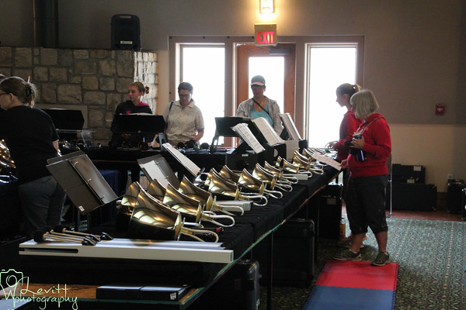
Check out our website…

Slide 17
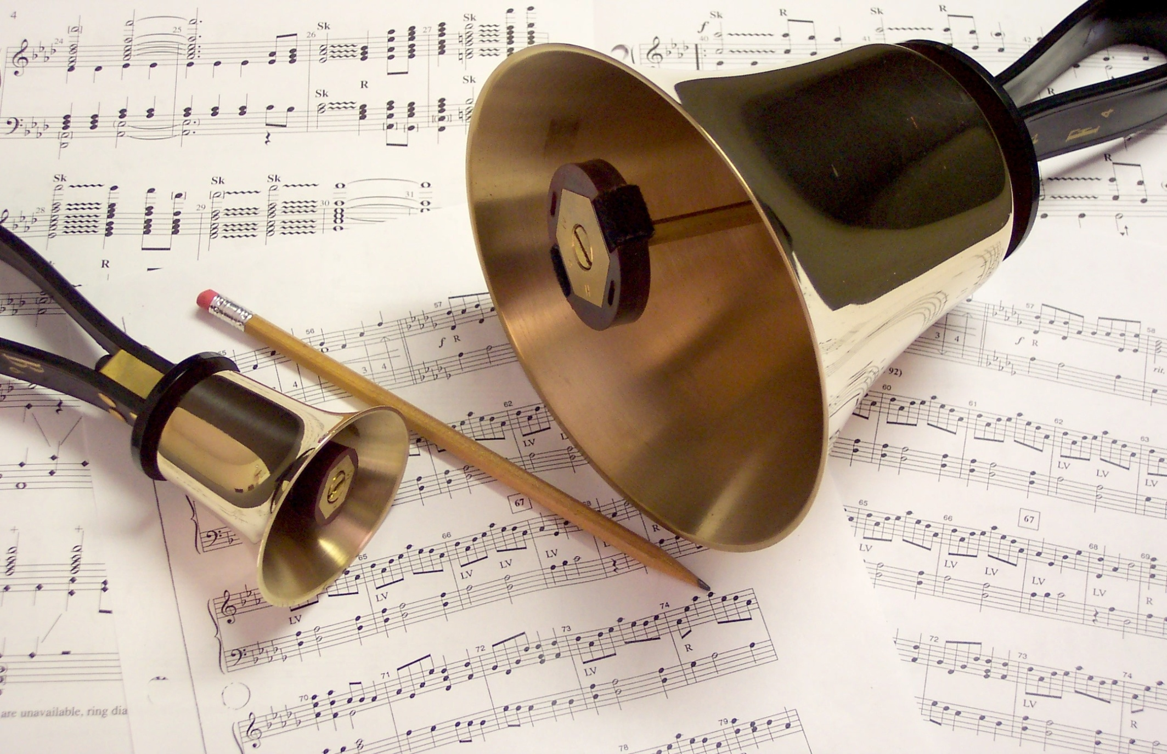
Handbellcamp.org
Join us next July!

Slide 18
Handbellcamp.org
July 8-12th 2018
Heartland Center - Parkville, MO

